Slide 1
Introductory General Chemistry
Chemistry 3A
S. M. Halloran

Slide 2
Visible Light in the EM Spectrum
Light Energy and Electrons: Orbiting Particles
Quantum Mechanics Describing Electrons
Valence & Core Electrons: Shells & Subshells
Configurations of Electrons Explaining Periodic Table Patterns
Atomic Size, Ionization Energy, Metallic and Nonmetallic Elements

Slide 3
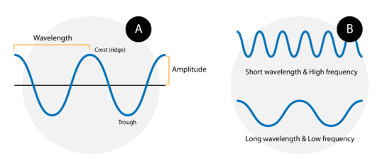
Waves
Crests, Troughs
Wavelength
Frequency/Period
Amplitude
Wave speed
Light as a wave
Speed/Frequency/Wavelength
Dimensional analysis

Slide 4
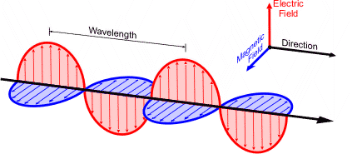
Waves

Slide 5
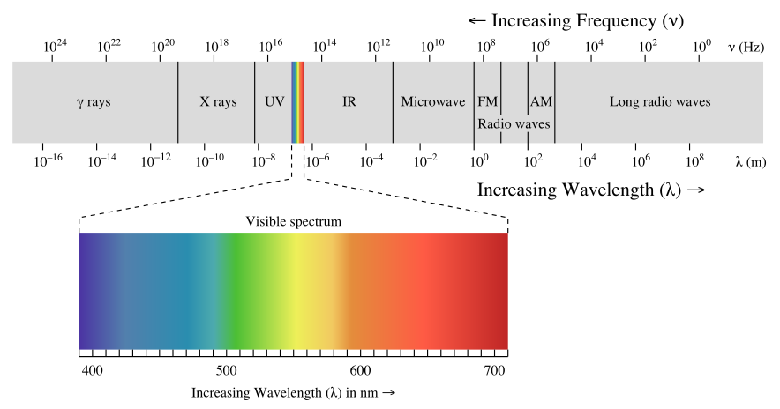
Electromagnetic Spectrum

Slide 6
Electromagnetic Spectrum

Slide 7
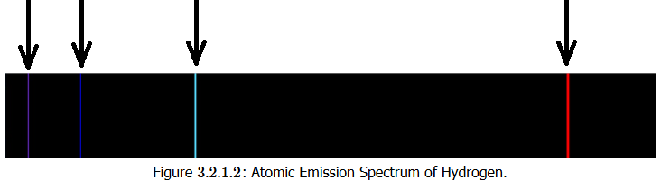
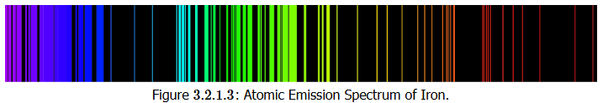
Emission Spectrum
Observations

Slide 8
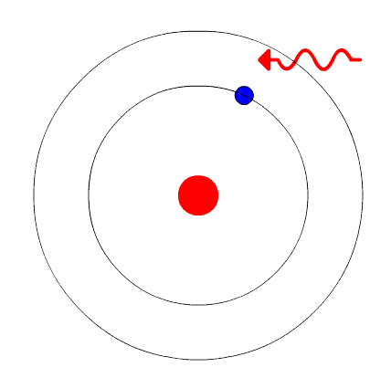
Atoms & Orbiting Electrons
The Bohr Model
Energy Levels
Ground state
Excited state
Photon
Quantized

Slide 9

Quantum Mechanics Model
Quantum Mechanics
Quanta
Orbits (orbital)
Schrodinger Equations (trivia only: no need to know this!)
Time-dependent: $iℏ\frac{∂}{∂t}Ψ=\hat{H}Ψ$
Time-independent: $\hat{HΨ}=EΨ$

Slide 10
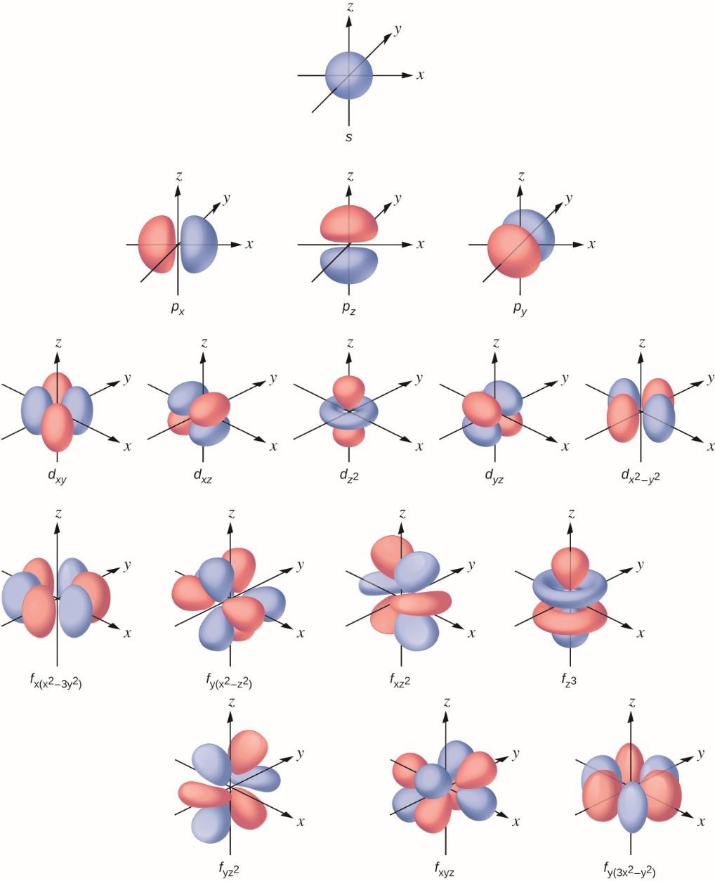
Orbitals and Electron Configurations

Slide 11
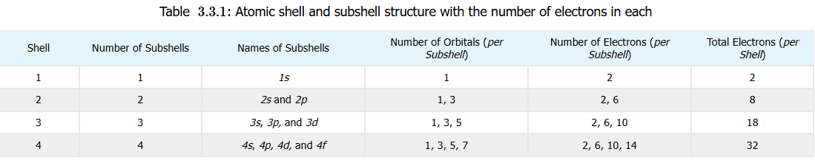
Orbitals and Electron Configurations

Slide 12
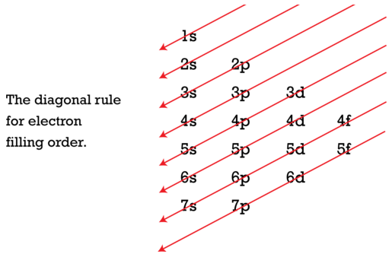
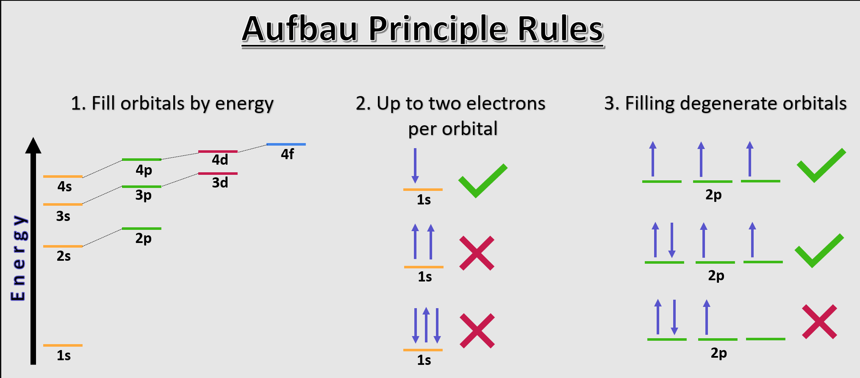
Orbitals and Electron Configurations
Second Period elements
Aufbau Principle

Slide 13
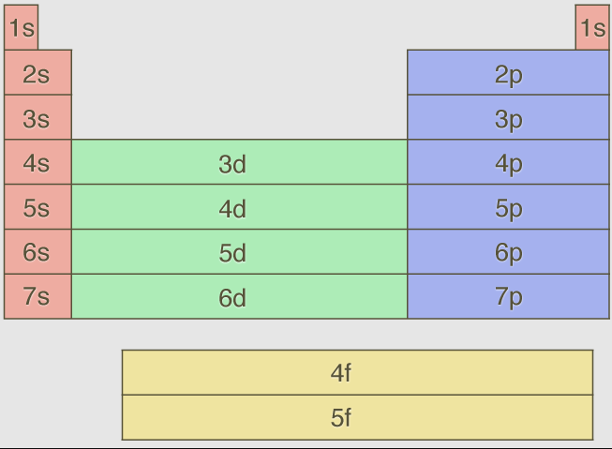
Orbitals and Electron Configurations

Slide 14
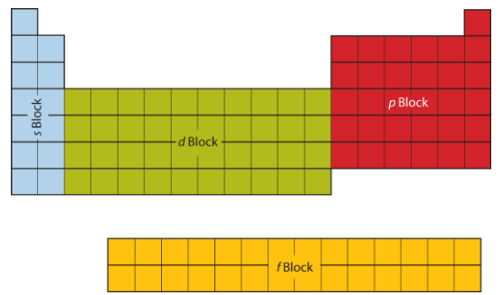
Orbitals and Electron Configurations
Pauli Exclusion Principle
Hund’s Rule
Core Electrons
Valence Electrons
Relationship of Electron Configurations and Periodic Table

Slide 15
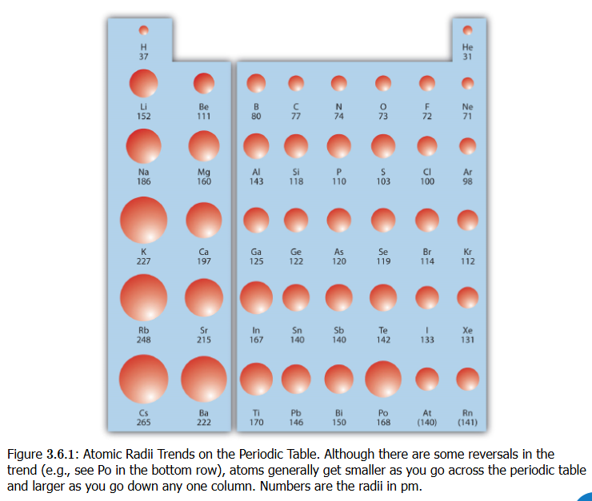
Atomic Radius (“size”)

Slide 16
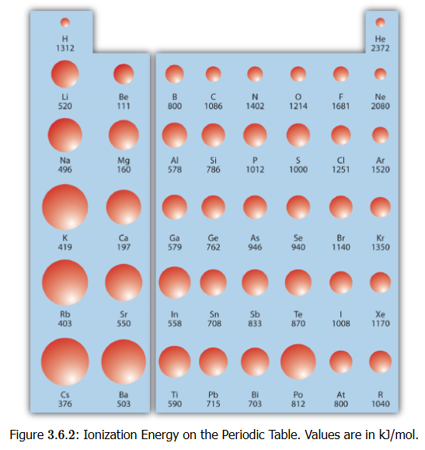
Ionization Energy

Slide 17
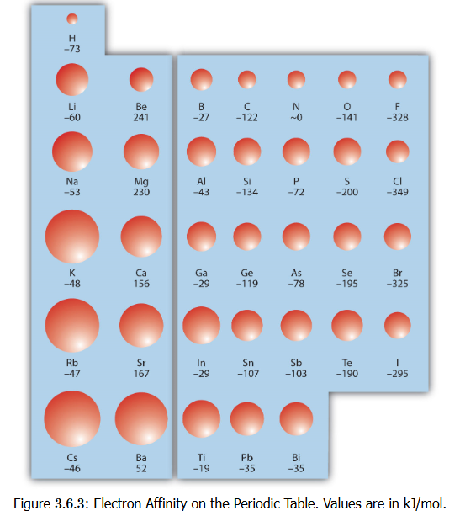
Electron Affinity (EA)

Slide 18
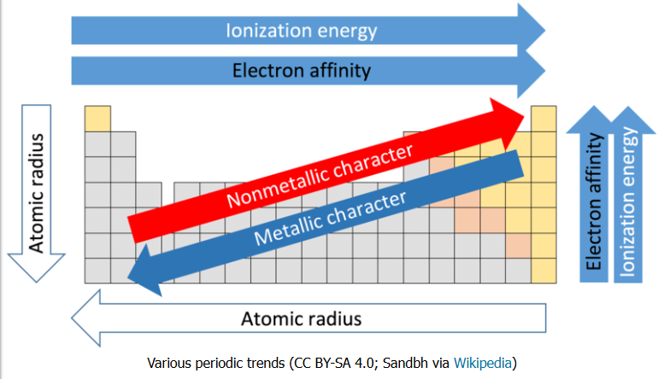
Summary of Periodic Trends

Slide 20
The Atom
Atoms are made of three subatomic particles
Protons
which actually give the element its identity
Electrons
chemistry is really about electrons, because it is electrons that allow atoms to bond to each other
Neutrons
it takes about 1800 electrons to equal mass of a proton, and the neutron is slightly bigger than the proton by 0.15%.
Because neutrons have a mass that is slightly higher than sum of a proton & electron, and because neutrons have been shown to decay to a proton, electron, and some other particles in physics, speculation is that a neutron is special gluing of a proton and electron.

Slide 21
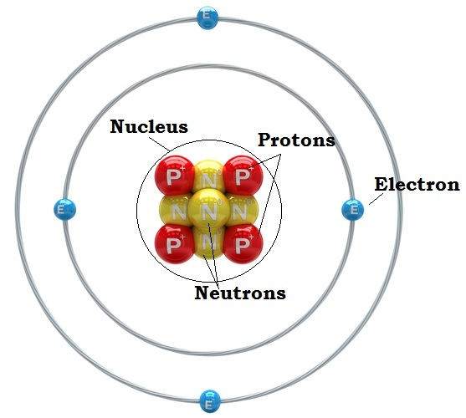
Nucleus & Orbitals
Protons and neutrons organized in the nucleus
Electrons spatially located outside of the nucleus
Electrons "orbit" the nucleus in orbitals but not like planets revolving around the sun
Their position/location is determined by probabilities calculated by complex mathematical expressions
Each orbital pairs two electrons of opposite spin
Yes, electrons have a spin just as the Earth rotates on an axis, and this spin generates a magnetic field

Slide 22

Atomic Weight
Why does hydrogen (H) have an atomic weight of 1.0079?
How is it calculated?

Slide 23
Atomic Weight Explained
Atoms are made of three subatomic particles
Protons
which actually give the element its identity
Electrons
chemistry is really about electrons, because it is electrons that allow atoms to bond to each other
Neutrons
it takes about 1800 electrons to equal mass of a proton, and the neutron is slightly bigger than the proton by 0.15%.
In fact, a neutron may be the combination of the mass of both 1 proton and 1 electron plus the Einstein energy (E = mc²) necessary to slam them together.
Neutrons can undergo radioactive decay into a particle that is +1 (proton or anti-proton) and –1 (electron) particles

Slide 24
Ions
electrically charged atoms and molecules
ionized atoms: Na⁺, Cl–, K⁺, Ca²⁺, Mg²⁺
ionized molecules
H₃O⁺, HPO₄^{2–}, NH₄⁺ C₄H₄O₄^{2–} (succinate: molecular formula) –OOC-CH₂-CH₂-COO– (succinate: structural formula)
cations: positively charged ions
move toward cathode (– pole)
anions: negatively charged ions
move toward anode (+ pole)

